Slide 1
Hobbies and Leisure
COSC122 Term 1

Slide 2
Introduction
During our day to day, there are times where the activities we perform can be overwhelming and we need to take a rest. This is where hobbies and leisure come in.
Hobbies can be defined activities that we enjoy doing and that normally done when we have free time with ourselves. They allow us to have “meaningful” moments in our lives.
Hobbies can come in a variety in different forms and flavours. Some can be more activities than others, while some can be more complex in general.
In this presentation, I will introduce some of my hobbies, as well as some benefits (general and category-specific) of them.

Slide 3



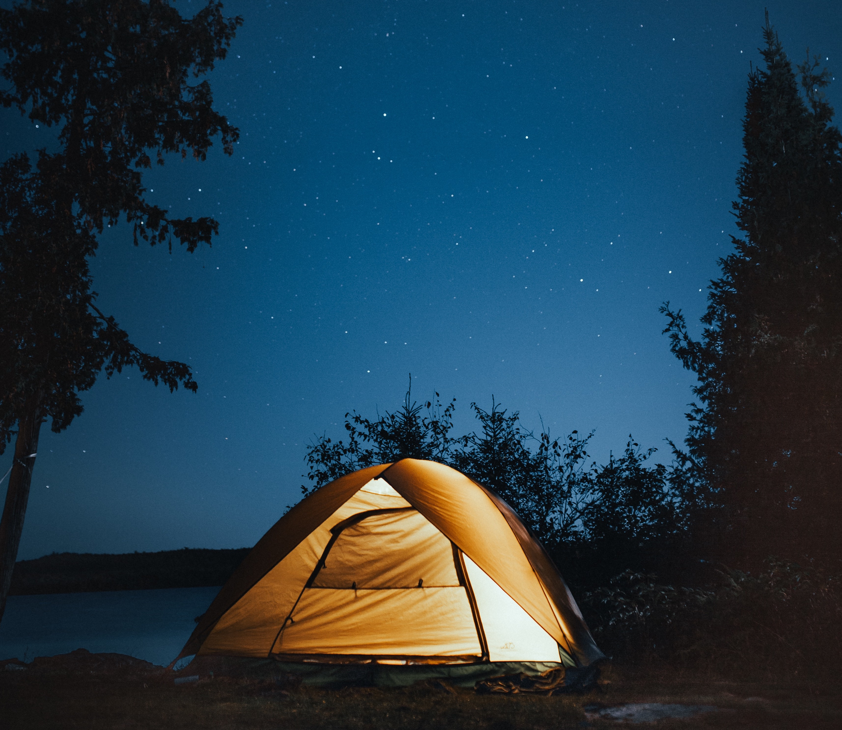
Types of Activities
Programming: Allows you to be creative and develop fun and interesting programs.
Cooking: Helps you prepare delicious food and explore/apply different techniques.
Sports: Helps you engage in a healthy lifestyle while sometimes allowing you to learn something new.
Camping: You can explore the world and can also be done with friends.
Photo by Alex Green
Photo by Joe L
Photo by Pixabay
Photo by Josh Hild

Slide 4
Benefits of Hobbies
Develop meaningful skills while having fun.
Connect with others with similar interests.
Opportunity to try new things.
Get to know yourself better.
Discover ideas you did not know before.

Slide 5


Outdoor vs Indoor Leisure Time
In general, there are benefits to both outdoor and indoor leisure time.
In the case of outdoors, you can physically move around, enjoy the weather, etc. However, indoor allows you to take time for yourself, spend time in your comfort space, and more.
In other words, no matter if it is an outdoor or indoor hobby, there is always something meaningful that can come out of it.

Slide 6
Summary
In summary, there are multiple activities a person can do to learn something new and fun or simply enjoy time.
There is a wide range of hobbies one can do, and these can vary based on amount of physical movement, skills being developed and more.
There is always something for everyone. The one thing you must do is explore and find what you like.

